Slide 1
Algorithms
Mushtari Sadia

Slide 2
Solving Recurrences

Slide 3
Solving Recurrences- Methods
Iteration Method
Recursion Tree Method
Master Theorem

Slide 4
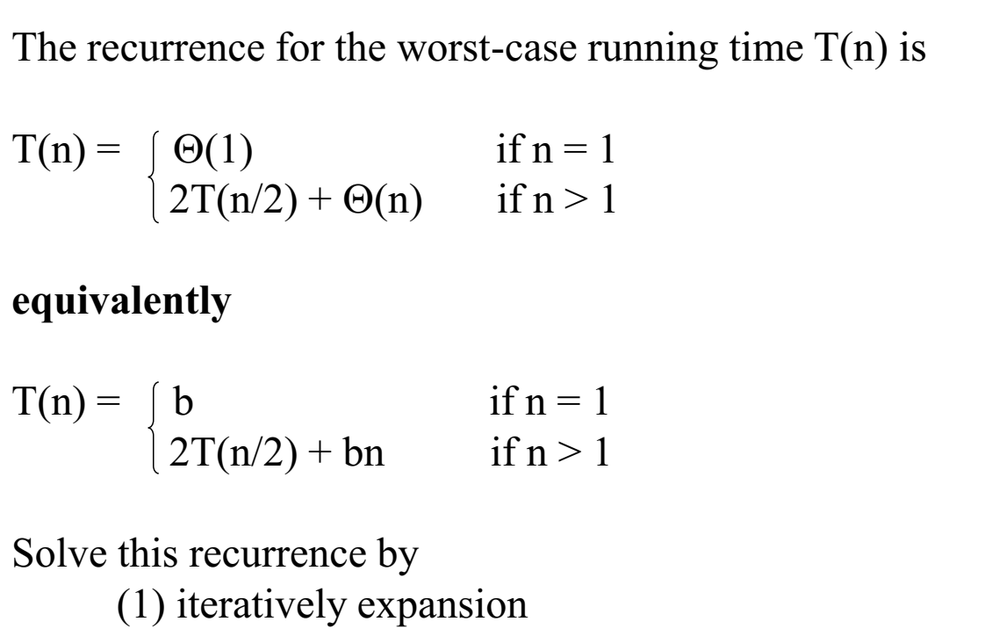
Merge Sort: Running Time

Slide 5
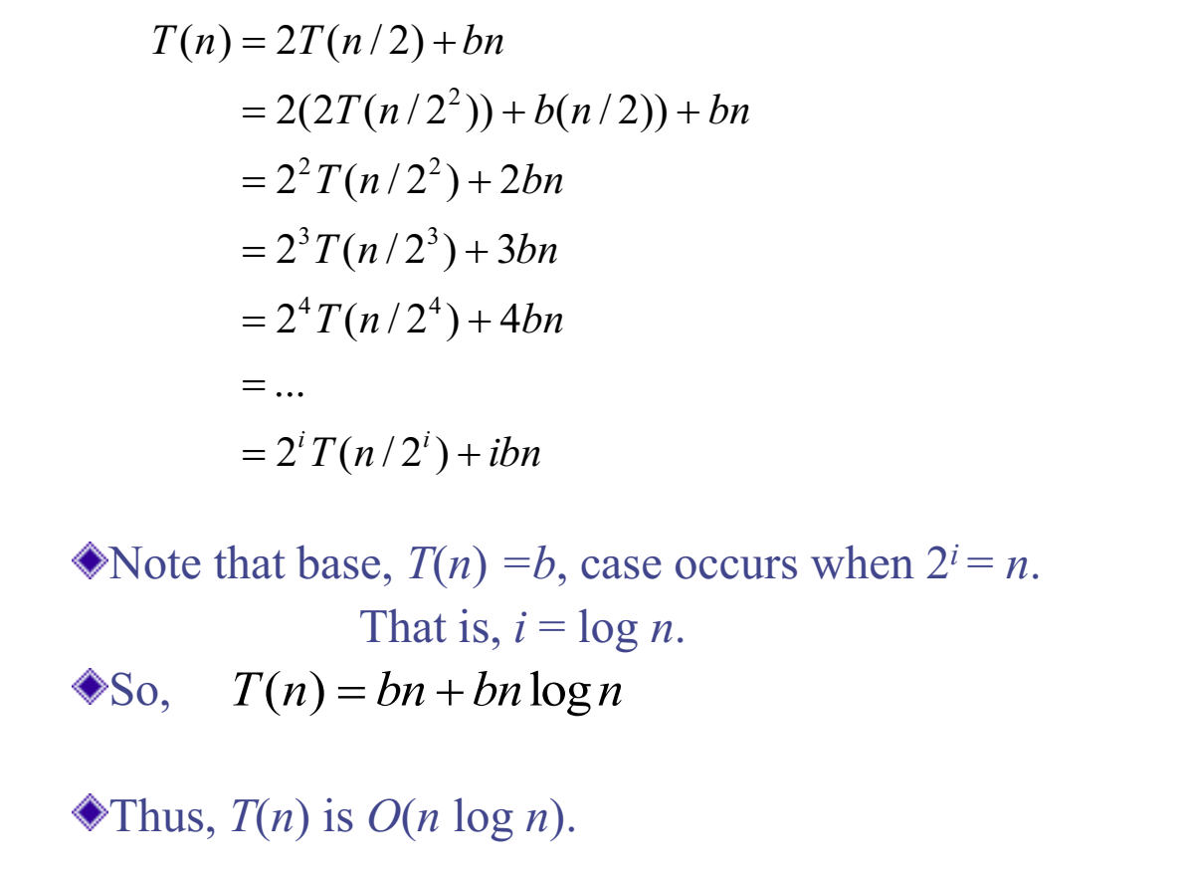
Merge Sort: Running Time

Slide 6
Iteration Method
Try:
T(n) = 4T(n/2) + bn
T(n) = 3T(n/2) + bn

Slide 7
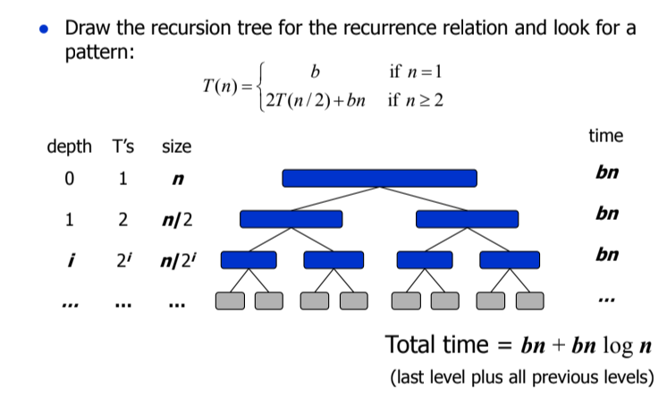
Recursion Tree Method

Slide 8
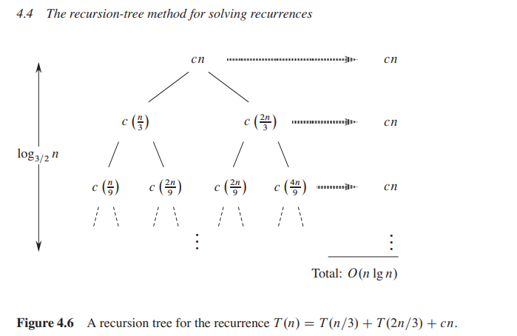
Recursion Tree Method

Slide 9
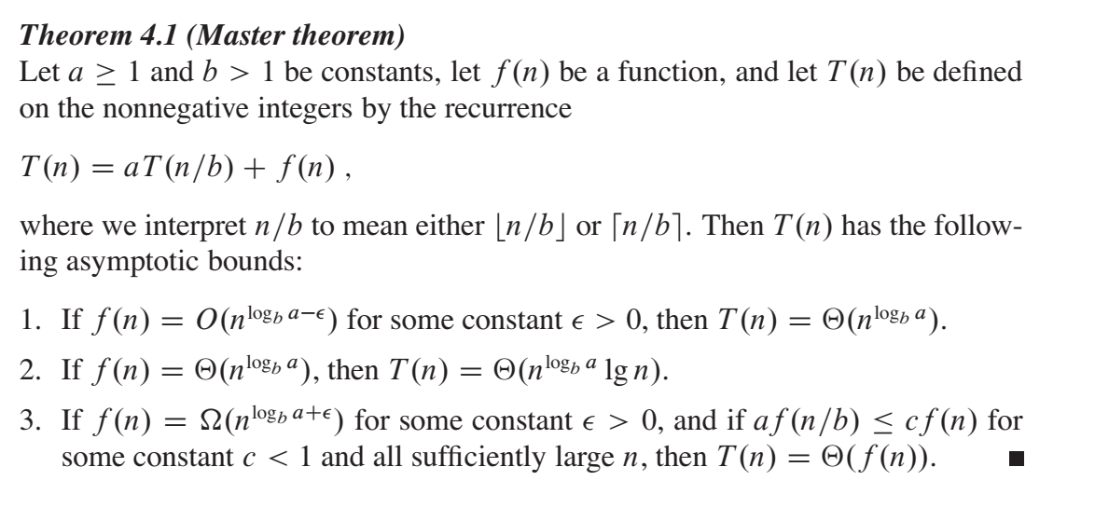
Master Theorem

Slide 10
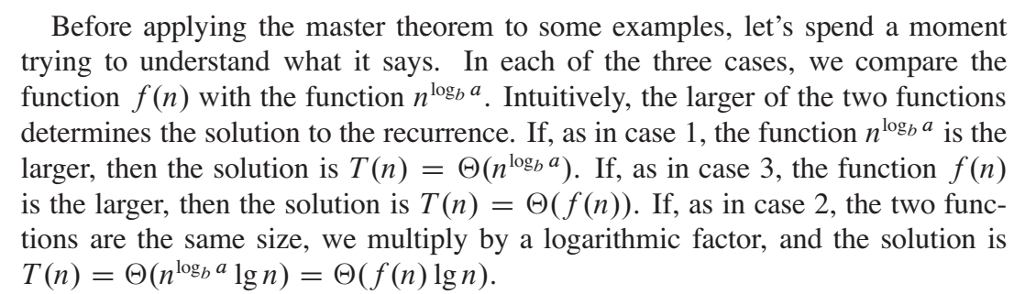
Master Theorem

Slide 11
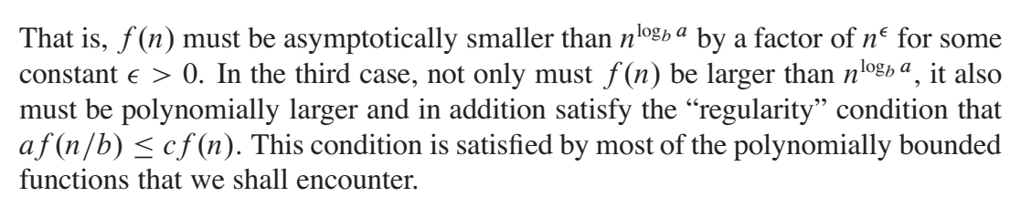
Master Theorem

Slide 12

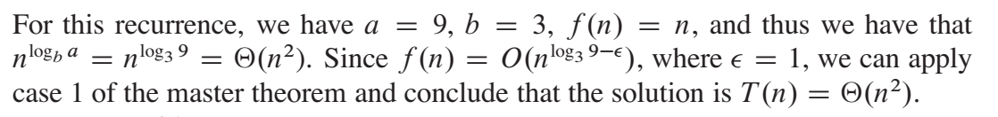
Master Theorem - Case 1 Example

Slide 13
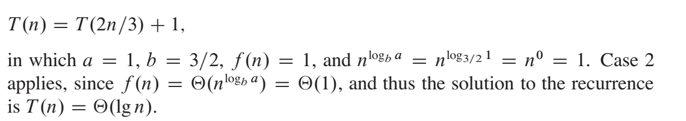
Master Theorem - Case 2 Example

Slide 14
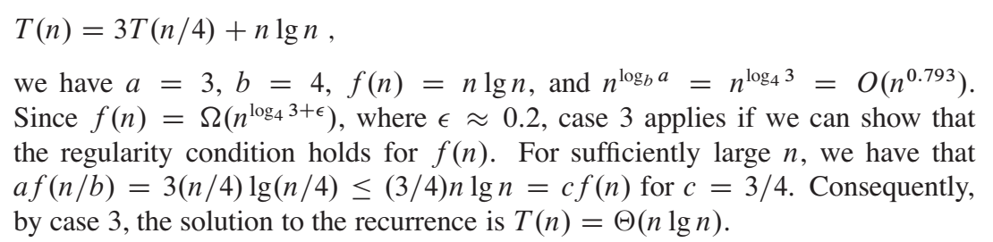
Master Theorem - Case 3 Example

Slide 15
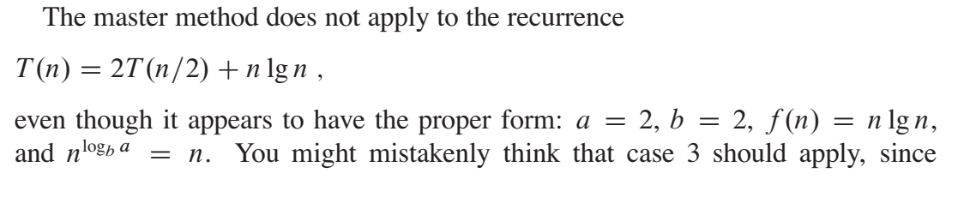
Master Theorem

Slide 16
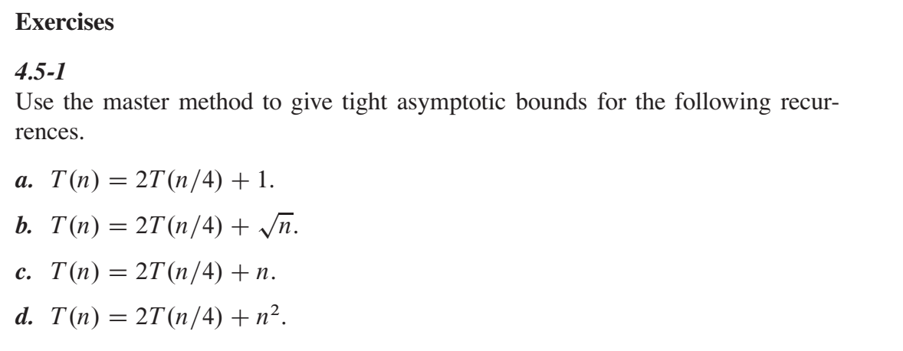
Master Theorem

Slide 17
Resources
CLRS book: Read chapter 4.5

